Slide 1
Automated Blood Donor Availability

Slide 2
Problem Statement
In emergency situations, finding a suitable blood donor quickly is often challenging.
Hospitals, NGOs, and individuals usually rely on manual communication methods such as phone calls, messages, or social media requests to locate donors.

Slide 3
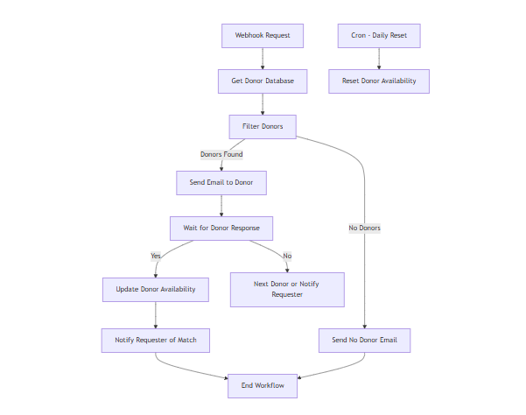
Workflow

Slide 4
Advantages
Fully automated process
Real-time donor availability
Reduces manual coordination
Scalable and customizable
Improves emergency response time

Slide 5
Future Enhancements
Integrate SMS/WhatsApp notifications
Add authentication and donor dashboard
Implement multi-city donor selection

Slide 6
THANK YOU
Byreddy Harshita

